Slide 1


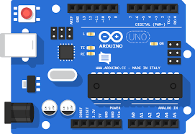
Andhra Pradesh State Skill Development Corporation
ARDUINO UNO
By,
B Nagaraju – APSSDC,
Technical Skill Trainer,
Phone no: +91-8463961431,
Mail id: Nagaraju.b@apssdc.in

Slide 2

What is Arduino?

Slide 3
Arduino is an open-source electronics platform based on easy-to-use hardware and software.
Arduino boards are able to read inputs - light on a sensor, a finger on a button, or a Twitter message - and turn it into an output - activating a motor, turning on an LED, publishing something online.
You can tell your board what to do by sending a set of instructions to the microcontroller on the board.
Arduino was born In 2005 at the Ivrea Interaction Design Institute as an easy tool for fast prototyping.

Slide 4

Why Arduino?

Slide 5
Arduino has been used in thousands of different projects and applications.
Arduino is a key tool to learn new things. Anyone - children, hobbyists, artists, programmers
Inexpensive - Arduino boards are relatively inexpensive compared to other microcontroller platforms.
Cross-platform - The Arduino Software (IDE) runs on Windows, Macintosh OSX, and Linux operating systems. Most microcontroller systems are limited to Windows.
Simple, clear programming environment - The Arduino Software (IDE) is easy-to-use for beginners
Open source and extensible software - The Arduino software is published as open source tools, available for extension by experienced programmers.
Open source and extensible hardware.

Slide 6
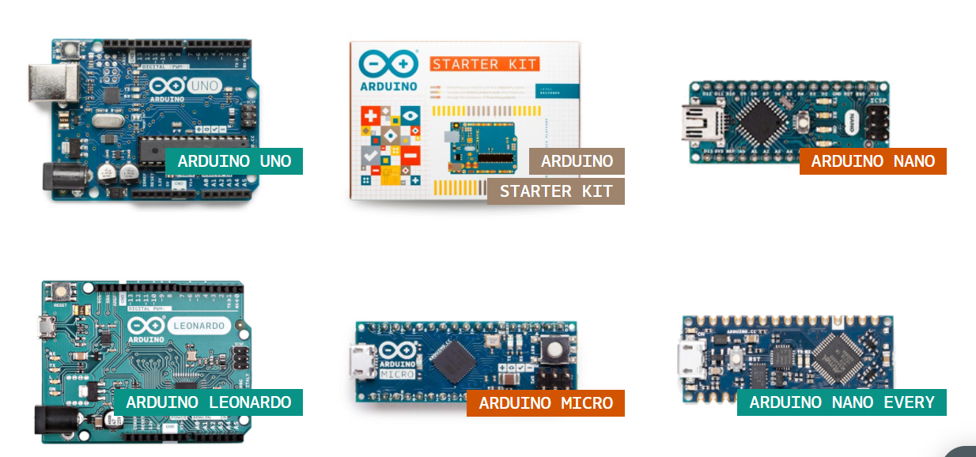
Arduino Products or Types
Entry Level

Slide 7
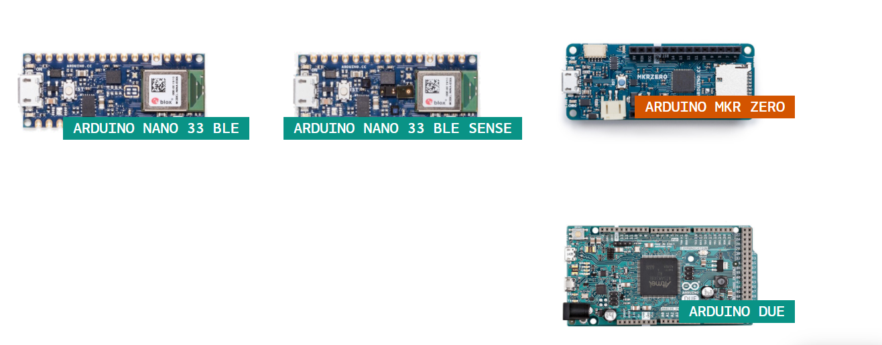
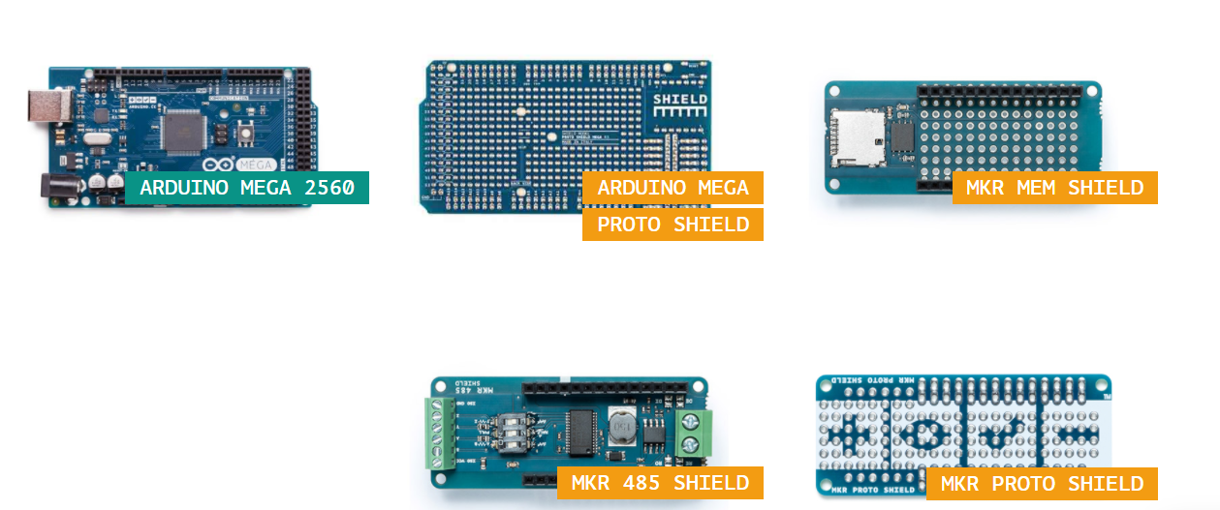
Enhanced Features

Slide 8
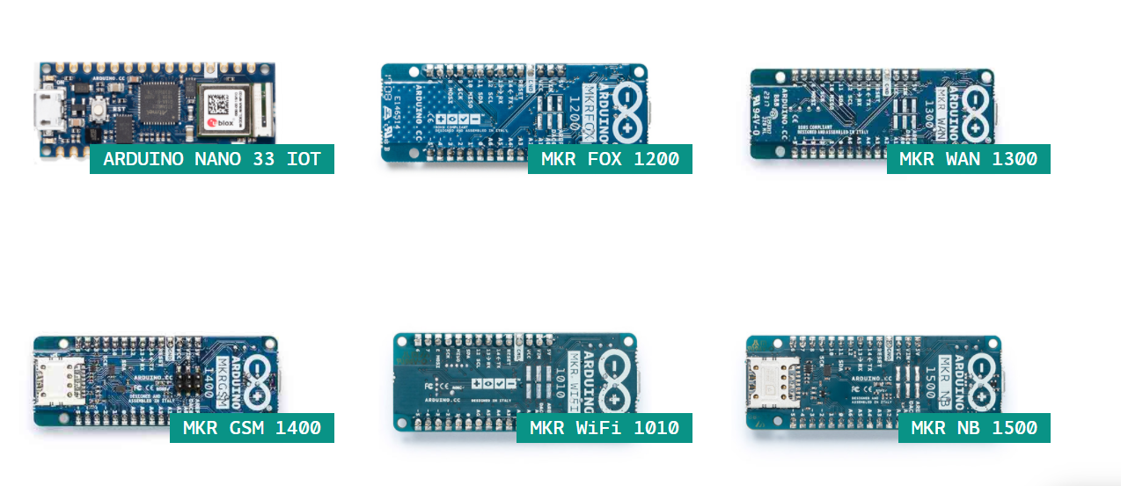
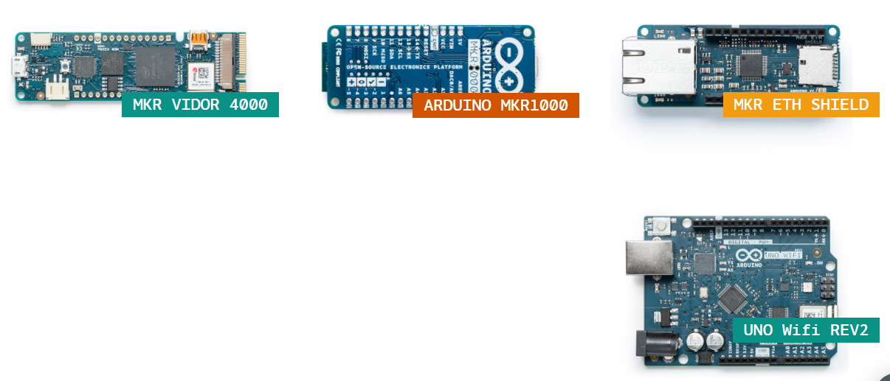
Internet of Things

Slide 9
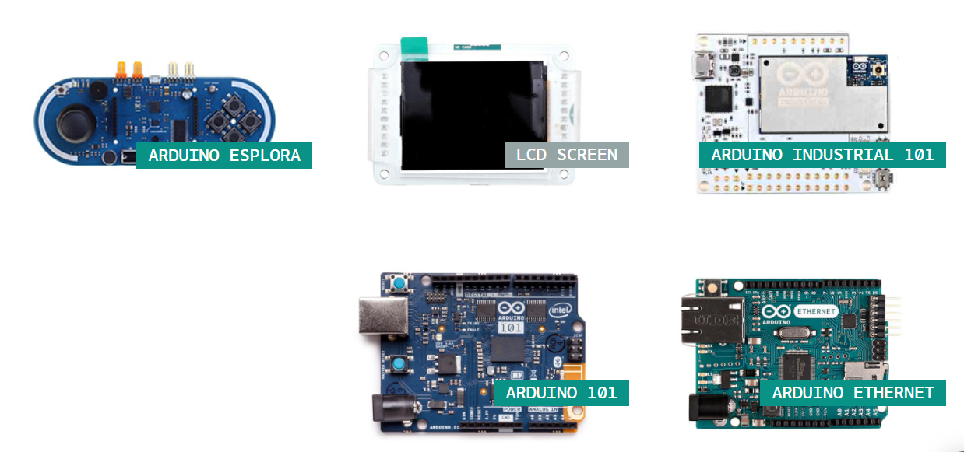
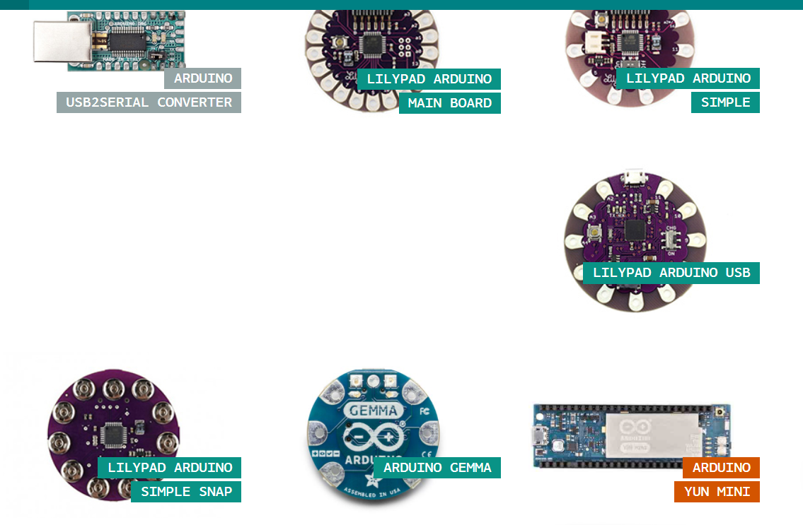
Retired

Slide 10
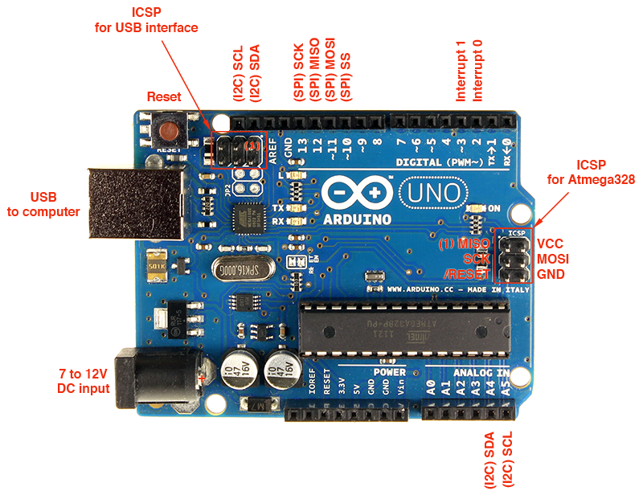
ARDUINO UNO

Slide 11
Arduino Uno is a microcontroller board based on the ATmega328P
It has 14 digital input/output pins (of which 6 can be used as PWM outputs), 6 analog inputs
a 16 MHz ceramic resonator (CSTCE16M0V53-R0)
a USB connection, a power jack, an ICSP header and a reset button.
simply connect it to a computer with a USB cable or power it with a AC-to-DC adapter or battery to get started
"Uno" means one in Italian

Slide 12
Technical Specification
Microcontroller : ATmega328P
Operating Voltage 5V
Input Voltage (recommended) 7-12V
Input Voltage (limit) 6-20V
Digital I/O Pins 14 (of which 6 provide PWM output)
PWM Digital I/O Pins 6
Analog Input Pins 6
DC Current per I/O Pin 20 mA
DC Current for 3.3V Pin 50 mA
Flash Memory 32 KB (ATmega328P) of which 0.5 KB used by bootloader
SRAM 2 KB (ATmega328P)
EEPROM 1 KB (ATmega328P)
Clock Speed 16 MHz
LED_BUILTIN 13
Weight 25 g

Slide 13
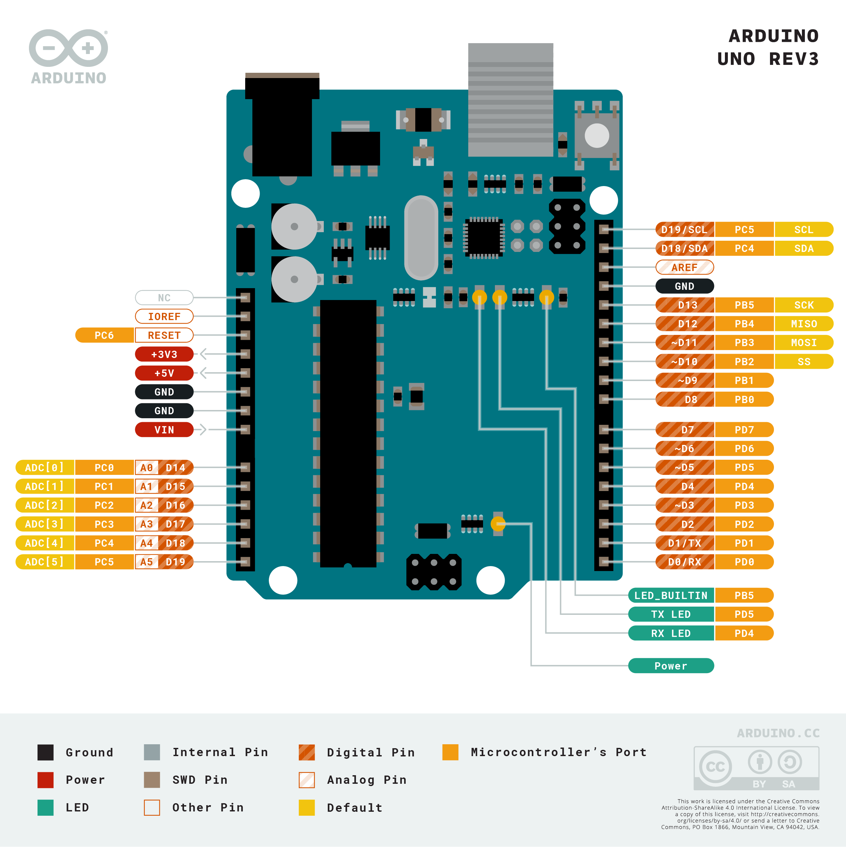
Pin Out:

Slide 14
How do I use Arduino?
BEFORE YOU START CONTROLLING YOU NEED TO SET UP THE SOFTWARE TO PROGRAM YOUR BOARD
The Arduino Software (IDE) allows you to write programs and upload them to your board. In the Arduino Software page you will find two options:
If you have a reliable Internet connection, you should use the online IDE (Arduino Web Editor). It will allow you to save your sketches in the cloud
If you would rather work offline, you should use the latest version of the desktop IDE.

Slide 15
Install the Arduino Desktop IDE

Slide 16
accordingly to your operating system.
Windows
Mac OS X
Linux
Portable IDE (Windows and Linux)
ChromeOS (Arduino Create Chrome App) for Individuals and for Education

Slide 17
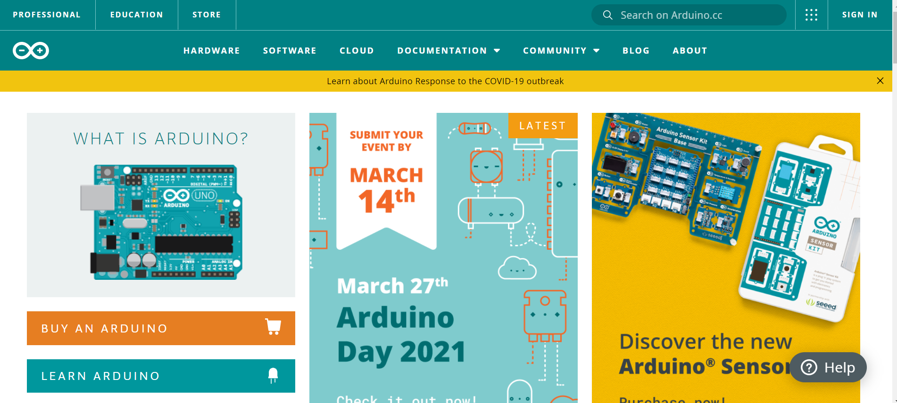
Install the Arduino Software (IDE) on Windows PCs
Get the latest version from the Arduino.cc web site

Slide 18
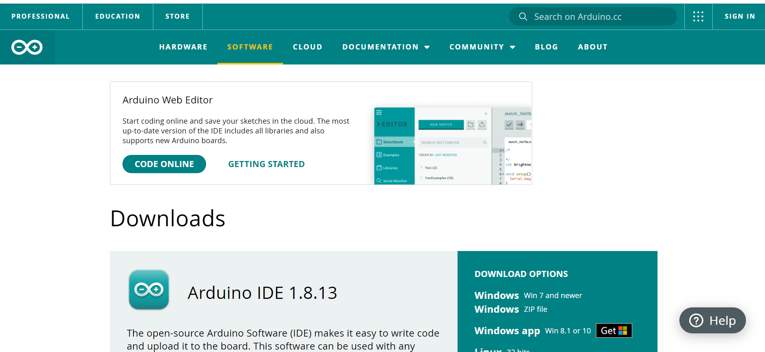
Select on software option

Slide 19
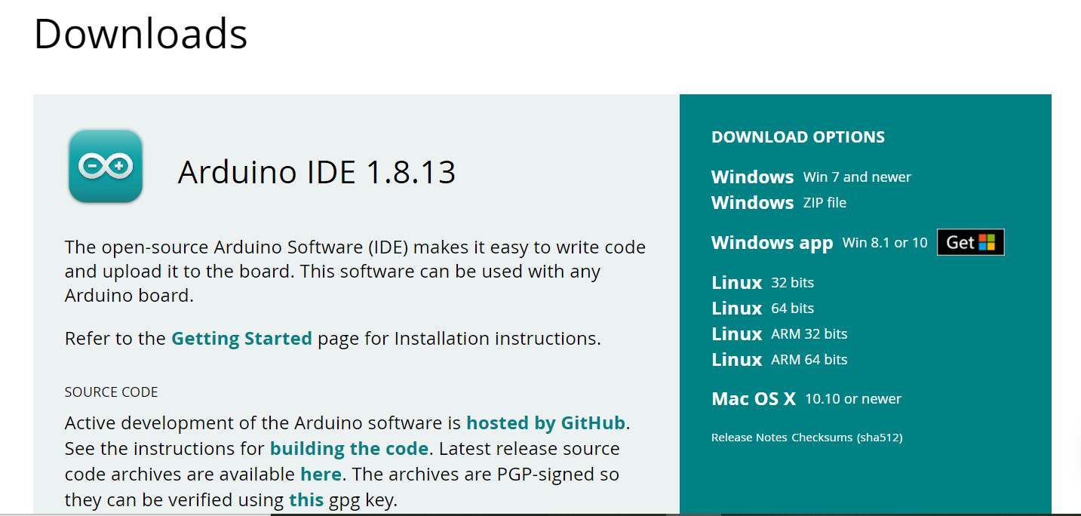
Select latest version of IDE and OS

Slide 20
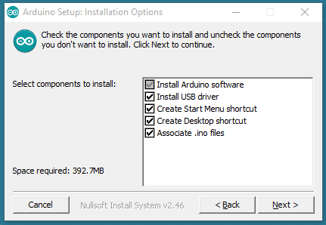
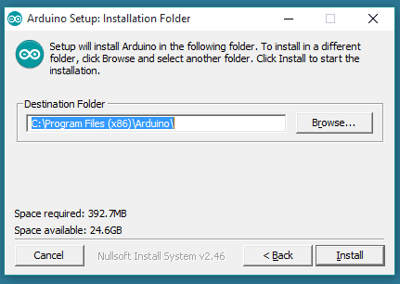
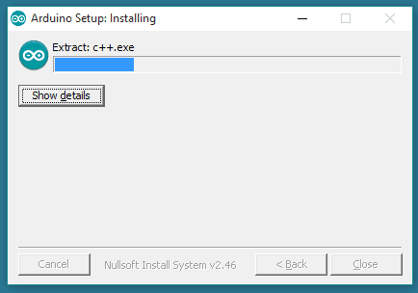
When the download finishes, proceed with the installation
The process will extract and install all the required files to execute properly the Arduino Software (IDE)

Slide 21
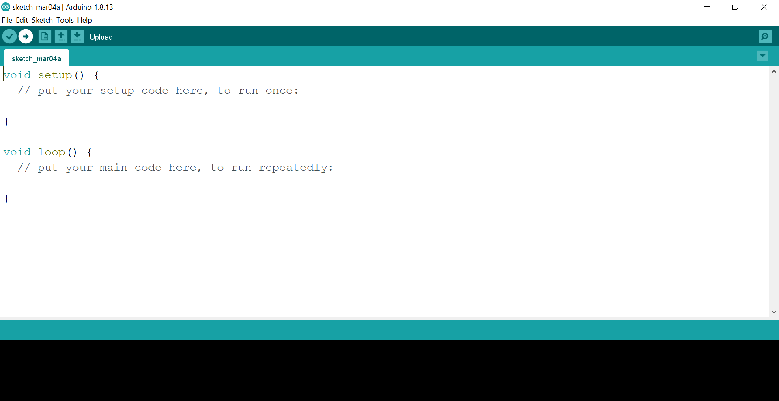
Arduino Software (IDE)

Slide 22
The Arduino Integrated Development Environment - or Arduino Software (IDE) - contains a text editor for writing code, a message area.
A toolbar with buttons for common functions and a series of menus.
Programs written using Arduino Software (IDE) are called sketches.
These sketches are written in the text editor and are saved with the file extension .ino.
The message area gives feedback while saving and exporting and also displays errors.
The bottom righthand corner of the window displays the configured board and serial port.
The toolbar buttons allow you to verify and upload programs, create, open, and save sketches, and open the serial monitor.

Slide 23
Writing Sketches:
Verify Checks your code for errors compiling it.
Upload Compiles your code and uploads it to the configured board. See uploading below for details.
New Creates a new sketch.
Open Presents a menu of all the sketches in your sketchbook. Clicking one will open it within the current window overwriting its content.
Save Saves your sketch.
Serial Monitor Opens the serial monitor.

Slide 24
Additional commands are found within the five menus: File, Edit, Sketch, Tools, Help.
File
New Creates a new instance of the editor, with the bare minimum structure of a sketch already in place.
Open Allows to load a sketch file browsing through the computer drives and folders.
Open Recent Provides a short list of the most recent sketches, ready to be opened.
Sketchbook Shows the current sketches within the sketchbook folder structure; clicking on any name opens the corresponding sketch in a new editor instance.
Examples Any example provided by the Arduino Software (IDE) or library shows up in this menu item. All the examples are structured in a tree that allows easy access by topic or library.
Close Closes the instance of the Arduino Software from which it is clicked.
Save Saves the sketch with the current name. If the file hasn't been named before, a name will be provided in a "Save as.." window.
Save as... Allows to save the current sketch with a different name.
Page Setup It shows the Page Setup window for printing.
Print Sends the current sketch to the printer according to the settings defined in Page Setup.
Preferences Opens the Preferences window where some settings of the IDE may be customized, as the language of the IDE interface.
Quit Closes all IDE windows. The same sketches open when Quit was chosen will be automatically reopened the next time you start the IDE.

Slide 25
Edit
Undo/Redo Goes back of one or more steps you did while editing; when you go back, you may go forward with Redo.
Cut Removes the selected text from the editor and places it into the clipboard.
Copy Duplicates the selected text in the editor and places it into the clipboard.
Copy for Forum Copies the code of your sketch to the clipboard in a form suitable for posting to the forum, complete with syntax coloring.
Copy as HTML Copies the code of your sketch to the clipboard as HTML, suitable for embedding in web pages.
Paste Puts the contents of the clipboard at the cursor position, in the editor.
Select All Selects and highlights the whole content of the editor.
Comment/Uncomment Puts or removes the // comment marker at the beginning of each selected line.
Increase/Decrease Indent Adds or subtracts a space at the beginning of each selected line, moving the text one space on the right or eliminating a space at the beginning.
Find Opens the Find and Replace window where you can specify text to search inside the current sketch according to several options.
Find Next Highlights the next occurrence - if any - of the string specified as the search item in the Find window, relative to the cursor position.
Find Previous Highlights the previous occurrence - if any - of the string specified as the search item in the Find window relative to the cursor position.

Slide 26
Sketch
Verify/Compile Checks your sketch for errors compiling it; it will report memory usage for code and variables in the console area.
Upload Compiles and loads the binary file onto the configured board through the configured Port.
Upload Using Programmer This will overwrite the bootloader on the board; you will need to use Tools > Burn Bootloader to restore it and be able to Upload to USB serial port again. However, it allows you to use the full capacity of the Flash memory for your sketch. Please note that this command will NOT burn the fuses. To do so a Tools -> Burn Bootloader command must be executed.
Export Compiled Binary Saves a .hex file that may be kept as archive or sent to the board using other tools.
Show Sketch Folder Opens the current sketch folder.
Include Library Adds a library to your sketch by inserting #include statements at the start of your code. For more details, see libraries below. Additionally, from this menu item you can access the Library Manager and import new libraries from .zip files.
Add File... Adds a source file to the sketch (it will be copied from its current location). The new file appears in a new tab in the sketch window. Files can be removed from the sketch using the tab menu accessible clicking on the small triangle icon below the serial monitor one on the right side o the toolbar.

Slide 27
Tools
Auto Format This formats your code nicely: i.e. indents it so that opening and closing curly braces line up, and that the statements inside curly braces are indented more.
Archive Sketch Archives a copy of the current sketch in .zip format. The archive is placed in the same directory as the sketch.
Fix Encoding & Reload Fixes possible discrepancies between the editor char map encoding and other operating systems char maps.
Serial Monitor Opens the serial monitor window and initiates the exchange of data with any connected board on the currently selected Port. This usually resets the board, if the board supports Reset over serial port opening.
Board Select the board that you're using. See below for descriptions of the various boards.
Port This menu contains all the serial devices (real or virtual) on your machine. It should automatically refresh every time you open the top-level tools menu.
Programmer For selecting a hardware programmer when programming a board or chip and not using the onboard USB-serial connection. Normally you won't need this, but if you're burning a bootloader to a new microcontroller, you will use this.
Burn Bootloader The items in this menu allow you to burn a bootloader onto the microcontroller on an Arduino board. This is not required for normal use of an Arduino board but is useful if you purchase a new ATmega microcontroller (which normally come without a bootloader). Ensure that you've selected the correct board from the Boards menu before burning the bootloader on the target board. This command also set the right fuses.

Slide 28
HOW TO WRITE PROGRAMMING/SKETCH IN ARDUINO IDE

Slide 29
Comments
/* Blink http://www.arduino.cc/en/Tutorial/Blink */
Everything between the /* and */ is ignored by the Arduino when it runs the sketch
Or
//Sample Blink program
There's another style for short, single-line comments. These start with // and continue to the end of the line. For example, in the line:
int ledPin = 13; // LED connected to digital pin 13

Slide 30
Variables
A variable is a place for storing a piece of data.
It has a name, a type, and a value.
For example, this statement (called a declaration):
int pin = 13;
you can refer to this variable by its name, at which point its value will be looked up and used. For example, in this statement:
pinMode(pin, OUTPUT); or pinMode(13, OUTPUT);
Most importantly, you can change the value of a variable using an assignment
For Example: pin = 12;

Slide 31
When you assign one variable to another.
Changing one has no effect on the other.
For example,
only pin has the value 12; pin2 is still 13
if you want to be able to use a variable anywhere in your program.
you can declare at the top of your code. This is called a global variable.
As you can see, pin is used in both the setup() and loop() functions.
int pin = 13; int pin2 = pin; pin = 12;
int pin = 13;
void setup()
{
pinMode(pin, OUTPUT);
}
void loop()
{
digitalWrite(pin, HIGH);
}

Slide 32
int pin = 13;
void setup()
{
pin = 12;
pinMode(pin, OUTPUT);
}
void loop()
{
digitalWrite(pin, HIGH);
}
Here, the digitalWrite() function called from loop() will be passed a value of 12, since that's the value that was assigned to the variable in the setup() function.

Slide 33
Functions
A function is a named piece of code that can be used from elsewhere in a sketch.
For example.
void setup()
{
pinMode(ledPin, OUTPUT); // sets the digital pin as output
}
here's the definition of the setup() function
The first line provides information about the function, like its name, "setup".
The code between the { and } is called the body of the function: what the function does.

Slide 34
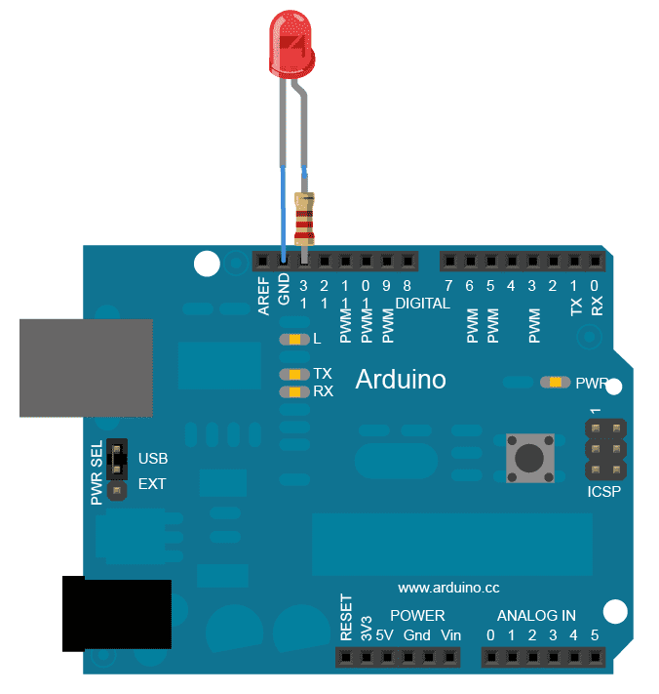
Basic LED Blink Program.
Int led=13;
setup()
{
pinMode(led, OUTPUT);
}
loop()
{
digitalWrite(led, HIGH);
delay(1000); // wait for a second
digitalWrite(led, LOW);
delay(1000); // wait for a second
}

Slide 35


